Slide 1
GRAAD: Group Anonymous Device-to-Device Communication in Mobile Networks
R.-H. Hsu, J. Lee, T.Q.S. Quek, and J.-C. Chen
IEEE Transactions on Information Forensics and Security, Vol. 13, No. 2, 2018

Slide 2
Outline
Introduction and Motivation
System and Security Models
Building Blocks
Proposed Schemes
Security Analysis
Performance Evaluation
Comparison
Conclusion
Notes:
hgfhgfdhgfdhgf

Slide 3
Device-to-Device Communications
Why Device-to-Device (D2D) Communications?
Offloading the traffic overhead of communication infrastructure
Real-time response to proximity-based applications

Slide 4




Controllable D2D Communications
Bob
Authentication Information for Alice
Who are Alice and Bob?
Who is Alice?
Home Subscriber Server
Authentication Center
Who is Bob?
Protected Identity Information
Base Station
Authentication Information for Bob
Alice

Slide 5





Security Threats in D2D Communications
Attacks for specific Apps
Usage of Apps
Keep group (application) information secure
Keep communication between devices secure
Trace randomized sessions and revoke users

Slide 6
Security Requirements in D2D Communications
Group Anonymity against Application Usage Disclosure
Bob
Authentication Information for Alice
Who are Alice and Bob?
End-to-End Secure Communication
Between Devices
Who is Alice?
Home Subscriber Server
Authentication Center
Accountable Membership Management for
Traceability and Revocability
Who is Bob?
Protected Identity Information
Base Station
Authentication Information for Bob
Alice

Slide 7
Identity Anonymity
Any two sessions of D2D communications cannot be indistinguished if there are issued by the same initiator or not, i.e., the ID of a communication session cannot be distinguished from a random string.

Slide 8
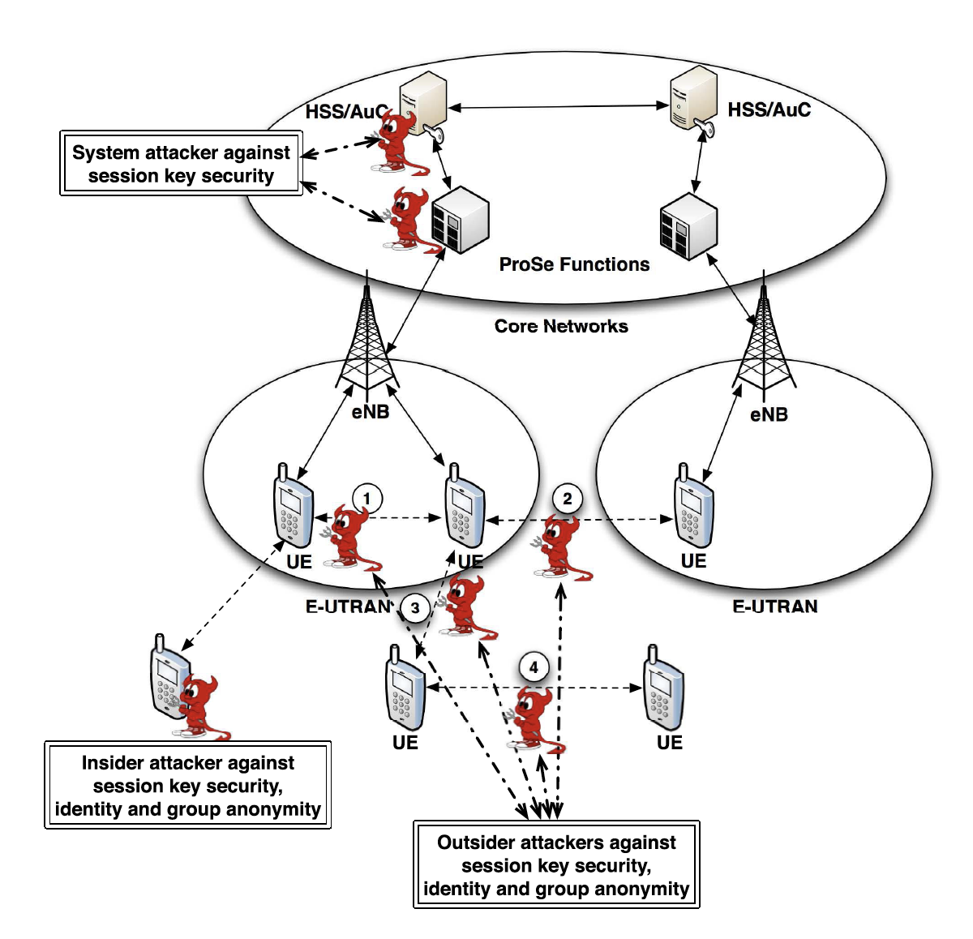
System and Attacker Models

Slide 9
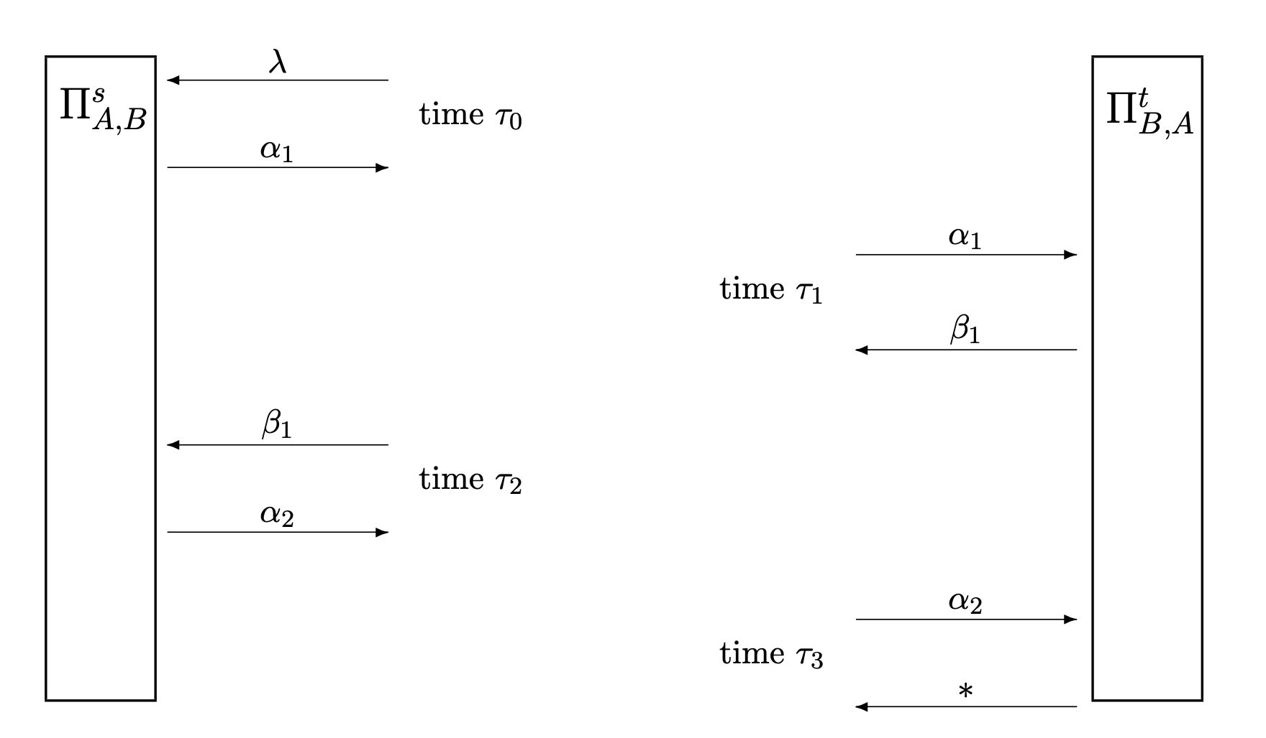
Security Definitions
Match conversation [1]
This is to ensure the conversation of each other matches.
No matching: There is no matching conversation, but a conversation is accepted.
Multiple matching: There are multiple conversations matched.
[1] M. Bellare and P. Rogaway, “Entity Authentication and Key Distribution,” Crypto’93.

Slide 10
Security Definition
The attackers can query the following oracles, Execute, Send, Reveal, Corrupt, Test, TestID, TestGroup.
Mutual Authentication:
Key Exchange Against System Operator:
Identity Anonymity:
Group Anonymity:

Slide 11
Security Definition
Identity Anonymity
Attackers allow to request Execute, Send, Reveal, Corrupt oracles to play with the simulated GRAAD protocols.
Attackers may attempt to break the identity anonymity by querying TestID oracle to obtain a real identity or a random string from the challenger depending on a random bit.
Group Anonymity
Most of the procedures are similar to that of the identity anonymity security game, execept the challenge phase.
Attackers may attempts to break the group anonymity by querying TestGroup oracle to obtain a real group identity or a random string from the challenger.

Slide 12
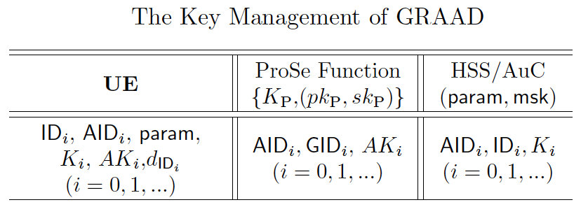
Network-Covered Group Anonymous D2D Authentication
UE shares ID_i, K_i, with HSS/AuC
UE shares AID_i, AK_i with ProSe function
ProSe function shares AID_i with HSS/AuC
HSS/AuC is key generation center to issue identity-based public and user private keys
ProSe function generates a unique secret key, Kp, and (pk_p, sk_p)

Slide 13
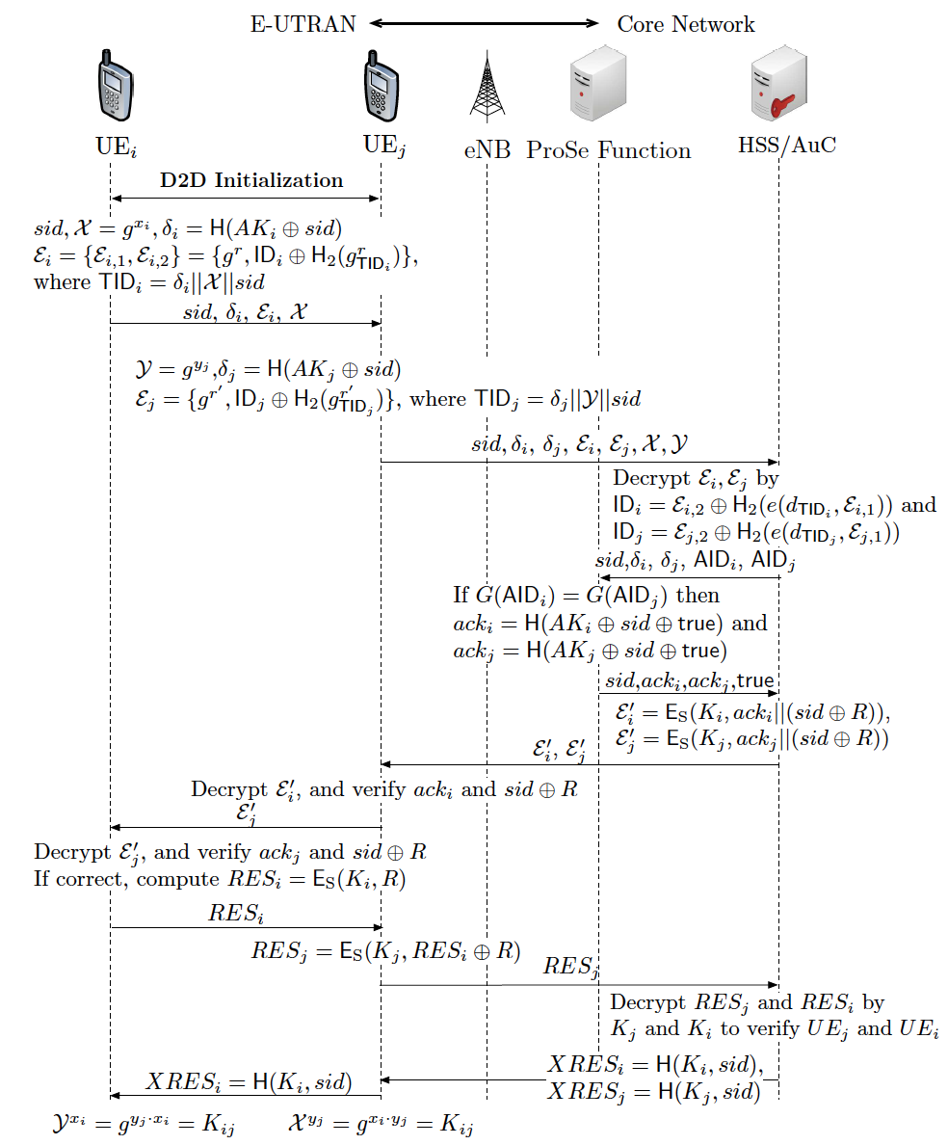

Slide 14
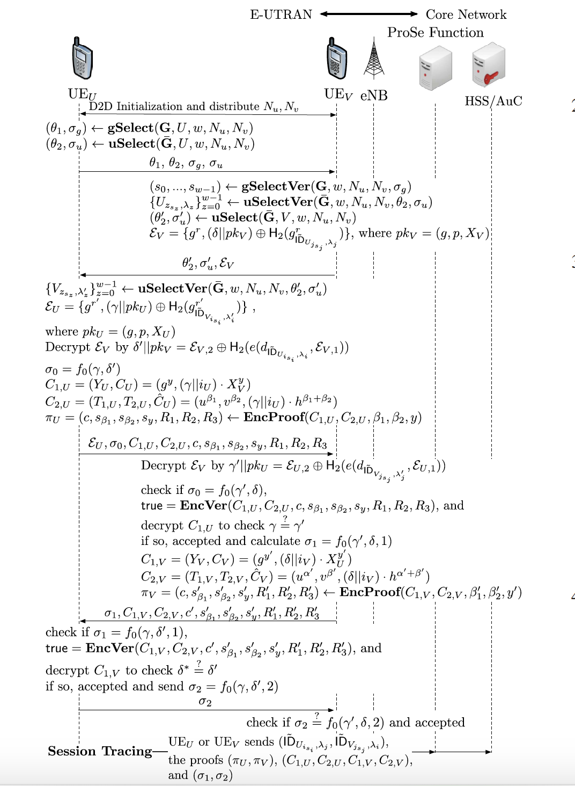
Network-absent D2D Communications

Slide 15
Group Anonymous for Network-absent D2D Communications
Commitments to group information
Two UEs in the same group will obtain the same random numbers to produce the same hash value
A
B

Slide 16



Traceability on Group Anonymity
Zero-knowledge proofs on two ciphertexts of the same message ^{[BBS04]}
A
Ciphertexts of A
……
Zero
Knowledge
Proof
……
Ciphertexts of B
B
Encryption of
user device
Encryption of
Authority
Message of Protocol
[BBS04] B. Boneh, X. Boyen, H. Shachum, “Short Group Signatures,” CRYPTO’04, 2004.

Slide 17

Performance Evaluation in D2D Communications
Evaluate authentication success rate (ASR) in D2D communication
M/G(D)/1 Queue, FCFS
A
CN-GD2C Authentication
C
Failed NA-GD2C Authentication
Target Device
Base Station
Failed CN-GD2C Authentication
B
* Residence times in the coverage of base station/device will affect ASR.

Slide 18
Performance Evaluation
Authentication Success and Failure Events
M/G(D)/1
Network-absent D2D Comm.
U
Residence time in D2D
Authentication time
(System waiting time)

Slide 19
Authentication Performance Evaluation in D2D Communications
Computation Complexity of Proposed Protocols
(Authentication Time)
(Waiting Time in Queue)
(Authentication Processing Time)
(Authentication Success Rate in NA-GD2C)
(Authentication Success Rate in CN-GD2C)

Slide 20
Security Proofs
Concept of Security Proofs
Ideal World -> Real World
Ideal World: The transcripts of the protocols are produced by the ideal functions, such as functions for mutual authentication, key exchange, identity anonymity, group anonymity, traceability, etc.
Real World: Replace the ideal functions with their implementation, such as pseudorandom functions, pseudorandom permutations, ID-based encryption, k-anonymity secret handshakes, zero-knowledge proof, etc.

Slide 21
Security Proofs
Ideal Functions
F_MA, F_KE, F_ID-Anon, F_G-Anon, F_Tr, etc.
Real Functions
Real Functions
F’_MA, F’_KE, F’_ID-Anon, F’_G-Anon, F’_Tr, etc.
F’_MA, F’_KE, F’_ID-Anon, F’_G-Anon, F’_Tr, etc.
Messages (Transcripts)

Slide 22
Security Proofs
Game-based security proofs
The transcripts of the protocols in game 0, Game_0, are all produced by ideal functions.
The attackers of the given proposed protocol in Game_0 have an advantage of breaking any one of the security features of the proposed protocol.
In each game, the ideal functions for one security feature will be replaced with the real functions.

Slide 23
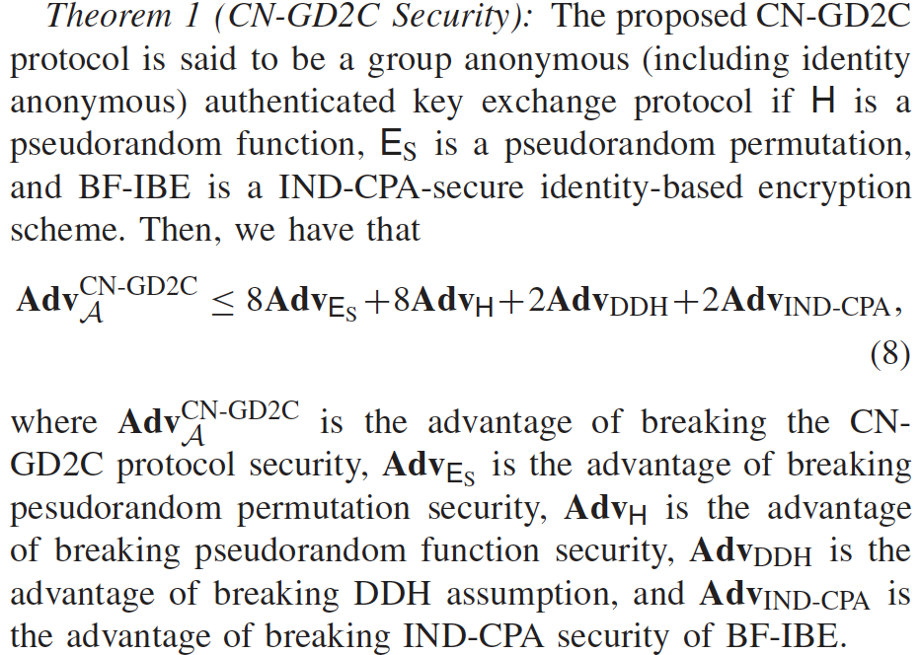
Security Proofs

